Slide 1
Regularizations
L1 and L2
Dropout
Call backs
Batch Normalizations
Weight Initializations
https://keras.io/api/callbacks/
https://www.kaggle.com/code/sid321axn/regularization-techniques-in-deep-learning#Dropout
https://www.kdnuggets.com/2019/08/keras-callbacks-explained-three-minutes.html
https://medium.com/@ompramod9921/callbacks-your-secret-weapon-in-machine-learning-b08ded5678f0
https://learnopencv.com/batch-normalization-in-deep-networks/

Slide 2
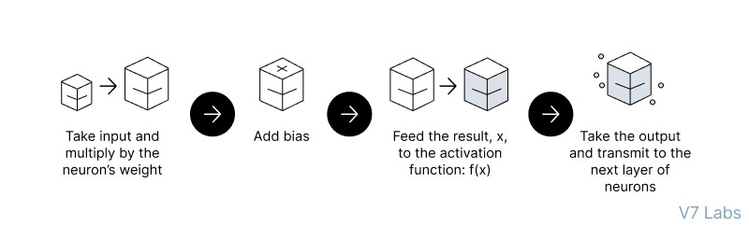
Feedforward Neural Networks (FNN):
the flow of information occurs in the forward direction. The input is used to calculate some intermediate function in the hidden layer, which is then used to calculate an output.
2. Backpropagation
- the weights of the network connections are repeatedly adjusted to minimize the difference between the actual output vector of the net and the desired output vector.
Implement the FNN
https://colab.research.google.com/drive/1z_nL3RcvR1x4uIR88VWEj8Zdr7mYEcQK#scrollTo=keCSdzvOrRmx

Slide 3
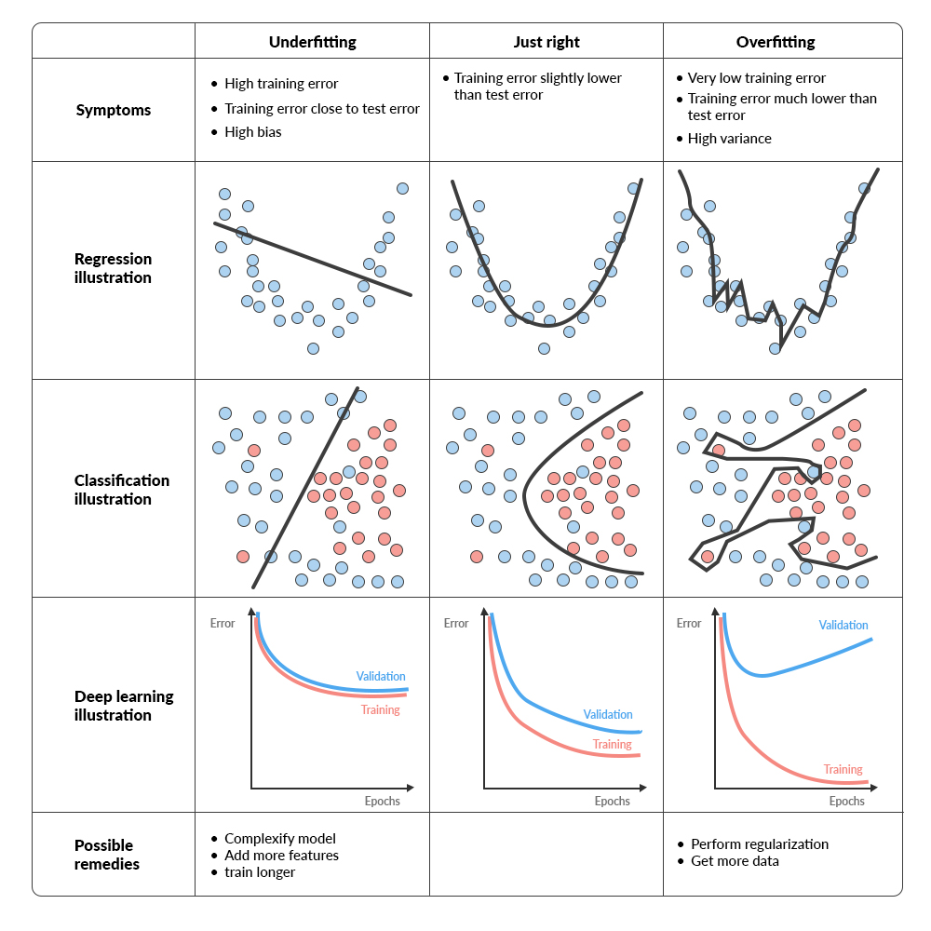

Slide 4
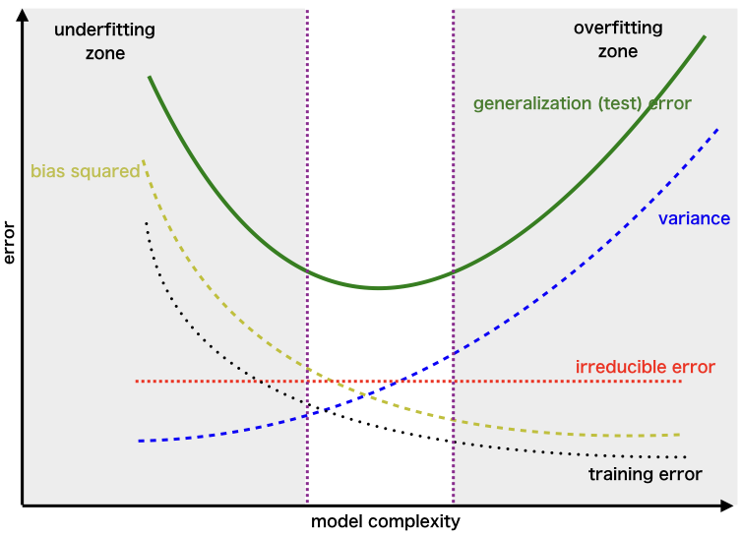
Bias Variance
https://uniathena.com/understanding-bias-variance-tradeoff-balance-model-performance

Slide 5
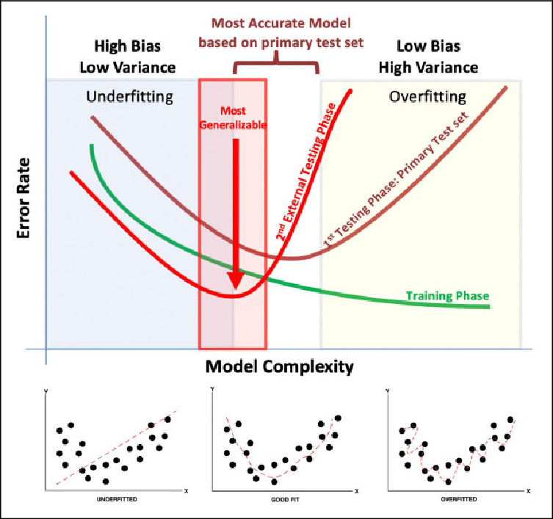

Slide 6
Regularization help reduce Overfitting?

Slide 7
Regularizations
Regularization techniques help improve a neural network’s generalization ability by reducing overfitting. They do this by minimizing needless complexity and exposing the network to more diverse data. This article will cover common regularization techniques:
L1(lasso) and L2(Ridge) regularization
Early stopping
Dropout
CallBack
Data augmentation
Addition of noise
https://zilliz.com/learn/understanding-regularization-in-nueral-networks

Slide 8
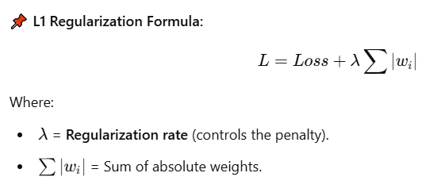
1️⃣ L1 Regularization (Lasso Regression)
📖 Definition:
L1 Regularization, also called Lasso (Least Absolute Shrinkage and Selection Operator), adds the absolute values of the weights to the loss function.
✅ Pros:
✔ Encourages sparse models (some weights become zero).
✔ Useful for feature selection (eliminates less important features).
❌ Cons:
❌ Can lead to unstable models when features are correlated.
❌ Not ideal for smooth weight shrinkage.
💻 Code Example (L1 Regularization in TensorFlow/Keras):
from tensorflow.keras.regularizers import l1
model.add(Dense(64, activation='relu', kernel_regularizer=l1(0.01))) # L1 penalty with lambda=0.01

Slide 9
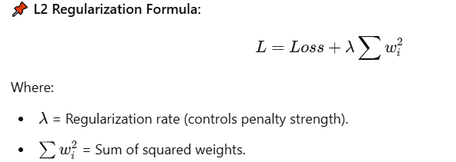
2. L2 Regularization (Ridge Regression)
📖 Definition:
L2 Regularization, also called Ridge Regression, adds the squared values of the weights to the loss function.
✅ Pros:
✔ Encourages smaller weights, preventing overfitting.
✔ Works well when features are correlated.
❌ Cons:
❌ Does not produce sparse models (all weights remain nonzero).
❌ May not be ideal for feature selection.
💻 Code Example (L2 Regularization in TensorFlow/Keras):
python
CopyEdit
from tensorflow.keras.regularizers import l2 model.add(Dense(64, activation='relu', kernel_regularizer=l2(0.01))) # L2 penalty with lambda=0.01

Slide 10
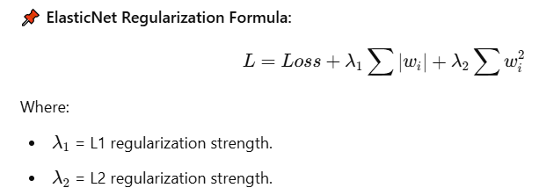
3. ElasticNet Regularization (Combination of L1 & L2)
📖 Definition:
ElasticNet is a hybrid of L1 and L2 regularization. It balances sparsity and smooth weight shrinkage.
📌 ElasticNet Regularization Formula:
✅ Pros:
✔ Provides the best of both L1 and L2.
✔ Works well when features are highly correlated.
❌ Cons:
❌ Requires tuning of both λ1 and λ2​.
💻 Code Example (ElasticNet in TensorFlow/Keras):
from tensorflow.keras.regularizers import l1_l2 model.add(Dense(64, activation='relu', kernel_regularizer=l1_l2(l1=0.01, l2=0.01)))

Slide 11
📌 Regularization Rate (Lambda, λ)
The regularization rateλ\lambdaλ controls how much penalty is applied to large weights:
Low λ → Less penalty (model can overfit).
High λ → More penalty (model can underfit).
Optimal λ → Found using hyperparameter tuning.
📌 Which One Should You Use?
If you want feature selection → L1 (Lasso).
If you want smooth weight shrinkage → L2 (Ridge).
If your data has correlated features → ElasticNet.

Slide 12
Why Use Absolute Value in L1 (Lasso)?
L1 Regularization adds the sum of the absolute values of weights to the loss function:
L=Loss+λ∑∣wi∣i​∣
📌 Key Properties of Absolute Value |w|:
The derivative of |w| is constant (except at zero):
If w>0w > 0w>0, derivative = +1+1+1.
If w<0w < 0w<0, derivative = −1-1−1.
If w=0w = 0w=0, derivative is undefined, but typically set to 0.
📌 Effect on Weights:
L1 applies equal pressure on all nonzero weights, regardless of size.
This forces some weights to become exactly zero, leading to feature selection (sparse models).
💡 Intuition: Imagine you want to shrink some weights to zero while allowing others to stay significant. The absolute value enforces this by applying a constant force that drives small weights to exactly zero.
🔍 Example Weight Update (Gradient Descent in L1):
If a weight is positive, it gets decreased.
If a weight is negative, it gets increased.
If a weight is small, it is forced to zero (sparse model).

Slide 13
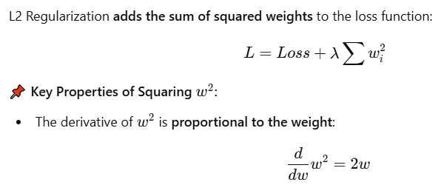
2 Why Use Squaring in L2 (Ridge)?
This means larger weights shrink faster, while smaller weights shrink more slowly.
📌 Effect on Weights:
L2 applies larger penalties to bigger weights, making the weight distribution smooth.
Unlike L1, L2 does not force weights to exactly zero, but shrinks them uniformly.
💡 Intuition: Think of squaring as a way to smoothly reduce large values rather than setting some to zero. It is like a spring that pulls weights back towards zero in a continuous way.
🔍 Example Weight Update (Gradient Descent in L2):
If a weight is large, the gradient (2w) is big, so it shrinks quickly.
If a weight is small, the gradient (2w) is small, so it shrinks slowly.
Why L1 Uses |w| and L2 Uses w^2?
| Property | L1 Regularization (|w|) | L2 Regularization (w^2) |
|----------- |---------------- |----------------|
| Penalty Type | Absolute value | Squared value |
| Effect on Weights | Some weights shrink to zero (sparse) | Weights shrink smoothly (small, but nonzero) |
| Best For | Feature selection (removes unnecessary weights) | Preventing overfitting (reduces large weights) |
| Weight Shrinkage | Equal shrinkage for all weights | Proportional shrinkage (larger weights shrink more) |
4 Why Not Swap Them?
If we used L1 with squared values, it wouldn't create sparsity (zero weights).
If we used L2 with absolute values, the gradient wouldn't smoothly reduce large weights.
The current setup is mathematically optimal for their respective goals.

Slide 14
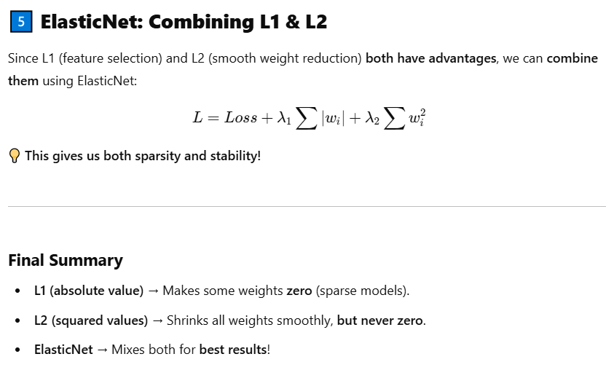

Slide 15
Reference
https://www.kaggle.com/code/sid321axn/regularization-techniques-in-deep-learning
https://www.pinecone.io/learn/regularization-in-neural-networks/
https://www.analyticsvidhya.com/blog/2018/04/fundamentals-deep-learning-regularization-techniques/#h-l2-amp-l1-regularization
https://www.geeksforgeeks.org/regularization-in-machine-learning/
https://dotnettutorials.net/lesson/dropout-layer-in-cnn/

Slide 16
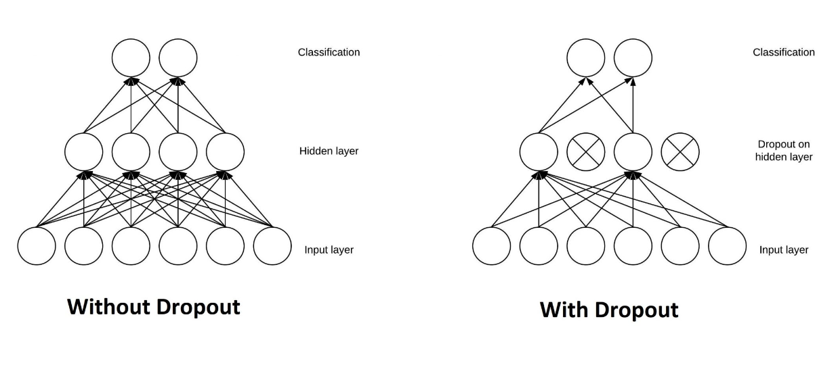
2. Dropout
What is a dropout in neural networks?
Dropout helps prevent overfitting by randomly nullifying outputs from neurons during the training process. This encourages the network to learn redundant representations for everything and hence, increases the model's ability to generalize.
self.dropout = nn.Dropout(0.25)
https://www.analyticsvidhya.com/blog/2022/08/dropout-regularization-in-deep-learning/

Slide 17
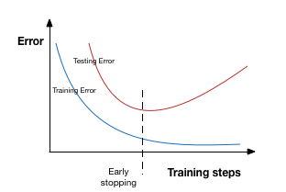
EarlyStop
Early stopping is a kind of cross-validation strategy where we keep one part of the training set as the validation set. When we see that the performance on the validation set is getting worse, we immediately stop the training on the model. This is known as early stopping.
In the above image, we will stop training at the dotted line since after that our model will start overfitting on the training data.
In keras, we can apply early stopping using the callbacks function. Below is the implementation code for it.I have applied early stopping so that it will stop immendiately if validation error will not decreased after 3 epochs.

Slide 18
from keras.callbacks import EarlyStopping
earlystop=EarlyStopping(monitor='val_acc',patience=3)
epochs=20#
batch_size=256

Slide 19
Call backs
Model Checkpoint
Early stoping
https://keras.io/api/callbacks/
What are Callbacks?
Callbacks are essentially functions or objects that are called at various points during the training process of a deep learning model.
They provide a way to inject custom behavior into the training process, allowing for greater control and flexibility.
You can use callbacks to automate tasks, monitor the training process, and even modify the training parameters dynamically.
Common Use Cases for Callbacks:
Saving Checkpoints: Periodically save the model's weights to disk, allowing you to resume training from a specific point or revert to the best performing model.
Early Stopping: Stop the training process if the model's performance on a validation set doesn't improve for a certain number of epochs, preventing overfitting.
Learning Rate Scheduling: Dynamically adjust the learning rate during training, which can help the model converge faster or escape local minima.
Logging Metrics: Log training metrics (e.g., loss, accuracy) to a file or visualize them using tools like TensorBoard.
Custom Actions: Implement custom actions, such as printing information, saving intermediate results, or triggering external events.

Slide 20
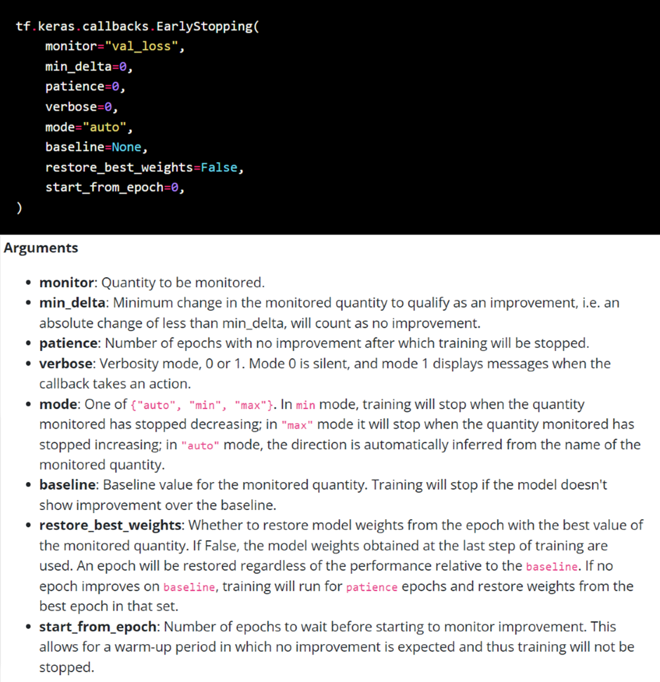
https://medium.com/@ompramod9921/callbacks-your-secret-weapon-in-machine-learning-b08ded5678f0

Slide 21
Batch Normalizations
Batch normalization is a technique used in deep learning to improve the training process by normalizing the activations of each layer, leading to faster convergence, higher learning rates, and improved generalization
https://learnopencv.com/batch-normalization-in-deep-networks/

Slide 22
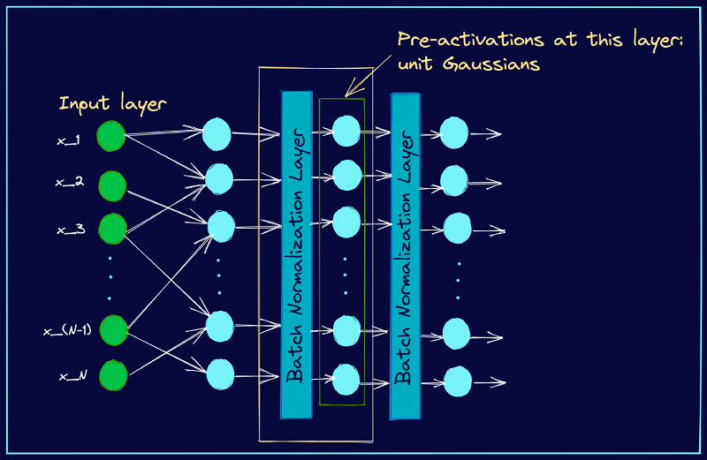

Slide 23
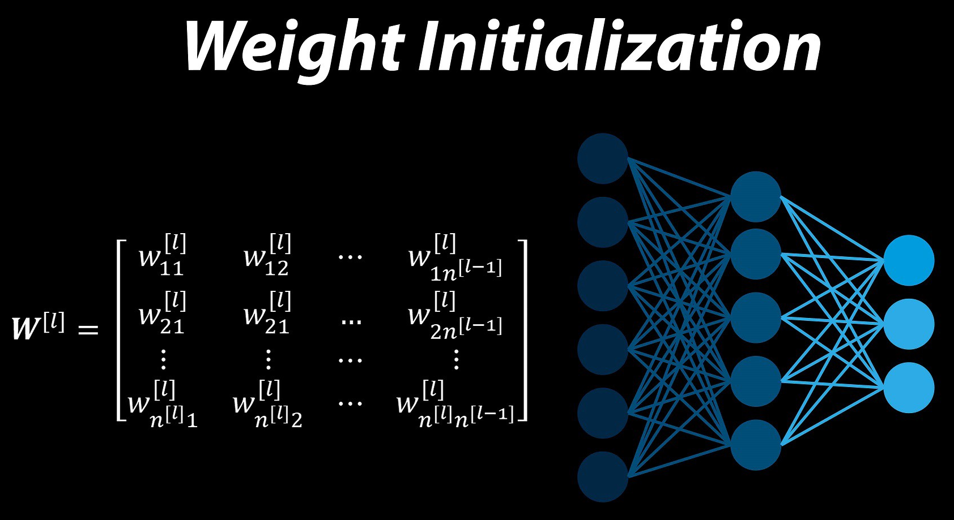
Weight Initializations

Slide 24
Weight initialization in neural networks is the process of assigning initial values to the network's parameters (weights and biases) before training, and it's crucial for efficient and effective learning, preventing issues like vanishing or exploding gradients.
Here's a more detailed explanation:
Why is it important?
Sets the starting point for learning:
The initial values of weights and biases determine where the network starts its optimization journey.
Influences convergence speed:
Poor initialization can lead to slow convergence or even prevent the network from learning effectively.
Avoids vanishing/exploding gradients:
If weights are initialized too small or too large, gradients can become extremely small (vanishing) or large (exploding) during backpropagation, hindering training.
Impacts activation function saturation:
Incorrect initialization can lead to activation functions saturating (e.g., sigmoid or tanh), which can also slow down learning.
Xavier/Glorat And He Weight Initialization in Deep Learning
Exponentially Weighted Moving Average or Exponential Weighted Average

Slide 25
Common Weight Initialization Techniques:
Zero Initialization:
Initializing all weights to zero. While simple, this approach is generally not recommended because all neurons will learn the same thing, and the network won't be able to break symmetry.
Random Initialization:
Assigning random values to weights, typically from a uniform or normal distribution. This breaks symmetry and allows neurons to learn different features, but if the values are too large or too small, it can lead to vanishing or exploding gradients.
Xavier/Glorot Initialization:
Designed for activation functions like sigmoid and tanh, this method aims to maintain the variance of activations across layers, preventing vanishing or exploding gradients.
He Initialization:
Specifically designed for ReLU activation functions, this method ensures that the variance of activations remains stable, which is important for ReLU's non-linearity.

Slide 26
Key Considerations:
Activation Function:
The choice of activation function (e.g., sigmoid, tanh, ReLU) influences the best weight initialization method.
Network Architecture:
The number of layers and neurons in a network can also affect the optimal initialization strategy.
Learning Rate:
The learning rate used during training can interact with the initialization method, so it's important to choose them carefully.
In summary, proper weight initialization is a crucial step in building neural networks, as it sets the stage for efficient and effective learning by preventing common problems like vanishing or exploding gradients and slow convergence.
https://www.geeksforgeeks.org/weight-initialization-techniques-for-deep-neural-networks/

Slide 27
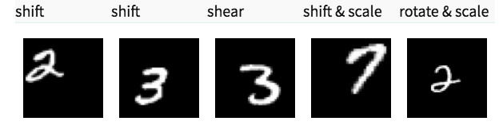
Data Augmentation
Data augmentation is a technique that artificially increases the size and diversity of a dataset by creating modified versions of existing data, primarily used to improve machine learning model performance, especially when data is scarce.
The simplest way to reduce overfitting is to increase the size of the training data. In machine learning, we were not able to increase the size of training data as the labeled data was too costly.
But, now let’s consider we are dealing with images. In this case, there are a few ways of increasing the size of the training data – rotating the image, flipping, scaling, shifting, etc. In the below image, some transformation has been done on the handwritten digits dataset.

Slide 28
Why is Data Augmentation Important?
Addressing Data Scarcity:
In many real-world scenarios, obtaining a large and diverse dataset can be challenging or expensive. Data augmentation helps overcome this limitation by generating more data from what's available.
Improving Model Generalization:
By exposing the model to a wider range of variations, data augmentation helps it learn more robust and generalizable features, reducing overfitting and improving performance on unseen data.
Enhancing Model Robustness:
Data augmentation can make models more resilient to noise, variations, and unexpected inputs.
Used in Computer Vision and NLP:
Data augmentation is particularly useful in computer vision (e.g., image rotation, flipping, cropping) and natural language processing (e.g., synonym replacement, random insertion/deletion).
Common Data Augmentation Techniques:
For Images:
Geometric Transformations: Rotation, scaling, translation, flipping, shearing.
Color Transformations: Brightness, contrast, saturation, hue adjustments.
Noise Addition: Adding Gaussian noise or salt-and-pepper noise.
Random Cropping: Randomly cropping portions of the image.
For Text:
Synonym Replacement: Replacing words with their synonyms.
Random Insertion/Deletion: Randomly inserting or deleting words or characters.
Back Translation: Translating text to another language and back to the original language.
Random Swap: Swapping words or characters.
For Audio:
Time Stretching: Changing the speed of the audio.
Pitch Shifting: Altering the pitch of the audio.
Adding Noise: Adding background noise.
For Time Series Data:
Adding Noise: Adding random noise to the time series data.
Time Warping: Distorting the time axis of the time series data.

Slide 29
from keras.preprocessing.image import ImageDataGenerator
datagen=ImageDataGenerator(featurewise_center=False,
# set input mean to 0 over the datasetsamplewise_center=False,# set each sample mean to 0featurewise_std_normalization=False,# divide inputs by std of the datasetsamplewise_std_normalization=False,# divide each input by its stdzca_whitening=False,# apply ZCA whiteningrotation_range=10,# randomly rotate images in the range (degrees, 0 to 180)zoom_range=0.1,# Randomly zoom image width_shift_range=0.1,# randomly shift images horizontally (fraction of total width)height_shift_range=0.1,# randomly shift images vertically (fraction of total height)horizontal_flip=False,# randomly flip imagesvertical_flip=False)# randomly flip imagesdatagen.fit(x_train)
https://www.datacamp.com/tutorial/complete-guide-data-augmentation

Slide 30
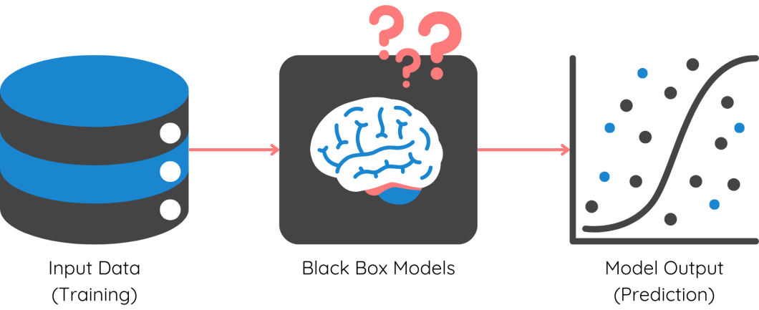
Model Expainlibility
LIME
SHAPY
https://viso.ai/deep-learning/explainable-ai/
https://www.datacamp.com/tutorial/explainable-ai-understanding-and-trusting-machine-learning-models
https://cloud.google.com/vertex-ai/docs/explainable-ai/overview
https://www.comet.com/site/blog/explainability-in-ai-and-machine-learning-systems-an-overview/

Slide 31
Explainable AI (XAI) helps humans understand and trust AI model outputs, especially important for generative AI models which can produce complex, potentially opaque outputs. XAI aims to make these models more transparent, allowing users to assess reliability, identify biases, and improve performance.
Here's a more detailed explanation:
What is Explainable AI (XAI)?
Transparency and Trust:
XAI focuses on making AI models and their decisions understandable to humans, fostering trust and confidence in their outputs.
Addressing "Black Box" AI:
Generative AI models, like deep neural networks, can be complex and difficult to interpret, often referred to as "black boxes". XAI aims to "open the hood" and reveal how these models arrive at their conclusions.
Benefits of XAI:
Assess Reliability: Understanding how a model reaches its conclusions allows users to determine if it's making accurate and consistent decisions.
Identify Biases: XAI can help detect and mitigate potential biases in the model's outputs.
Improve Model Performance: Insights from explanations can be used to refine model architecture and training data.
Compliance with Regulations: XAI helps meet regulatory requirements for transparency and accountability in AI systems.
Human-Centered Design: XAI ensures that AI systems are not only technically sound but also ethically and legally robust, particularly in situations where such qualities are essential.

Slide 32
XAI Techniques:
Feature-based explainability: Focuses on the importance of individual features in the model's predictions.
Sample-based explainability: Uses representative samples to explain the model's behavior.
Mechanistic approach: Examines the inner workings of the model itself.
Probing-based explainability: Involves examining the model's responses to various inputs.
Partial dependency plots: Show the marginal effect of an input feature on the predicted outcome.
SHAP (SHapley Additive exPlanations): Enables visualization of the contribution of each input feature to the output.
LIME (Local Interpretable Model-agnostic Explanations): Approximates locally a model's outputs with a simpler, interpretable model.
Why is XAI Important for Generative AI?
Complex Outputs:
Generative AI models produce artifacts (e.g., images, text, code) rather than simple decisions, making explainability even more crucial.
Trust and Adoption:
As generative AI technologies mature and are applied to more critical domains, explainability becomes essential for fostering trust and ensuring responsible deployment.
Ethical Considerations:
XAI helps ensure that generative AI systems are aligned with human values and ethics, addressing potential biases and unintended consequences.
Verifiability and Validation:
XAI enables the constructive verification of both AI model outputs and human decisions/intuitions, thereby deepening our comprehension of data and phenomena.

Slide 33
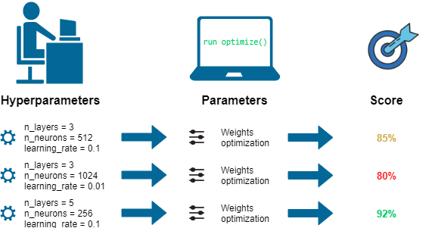
keras tunier -->tf
optima --> pytorch
HyperParameter tuning
Hyperparameter tuning in deep learning for generative AI involves optimizing model parameters (like learning rate, batch size, and number of epochs) to improve performance and efficiency, using techniques like grid search, random search, or Bayesian optimization
Model parameters | Hyperparameters
https://www.leewayhertz.com/hyperparameter-tuning/
https://www.geeksforgeeks.org/hyperparameter-tuning/
https://www.scaler.com/topics/deep-learning/neural-network-hyperparameters-tuning/
https://www.analyticsvidhya.com/blog/2021/05/tuning-the-hyperparameters-and-layers-of-neural-network-deep-learning/

Slide 34
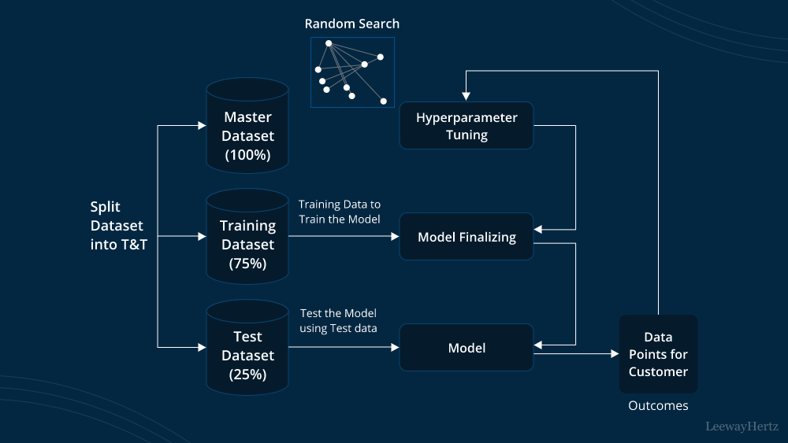

Slide 35
Why is Hyperparameter Tuning Important?
The choice of hyperparameters can significantly impact the model's performance, accuracy, and efficiency.
Poorly chosen hyperparameters can lead to slow training, poor generalization, or even model failure.
Tuning hyperparameters helps find the optimal configuration for a specific task and dataset.
Hyperparameter Tuning Techniques:
Manual Search: Experimenting with different hyperparameter values by hand.
Grid Search: Evaluating all possible combinations of hyperparameters within a predefined range.
Random Search: Randomly sampling hyperparameter values from a predefined range.
Bayesian Optimization: Using a probabilistic model to guide the search for optimal hyperparameters, leveraging previous evaluations.
Automated Hyperparameter Tuning: Tools and libraries that automate the hyperparameter tuning process (e.g., HyperOpt, Tune)
What are Hyperparameters?
Hyperparameters are settings that control the learning process of a machine learning model, but are not learned during training.
They are set before the training begins and influence how the model learns from the data
.
Examples of hyperparameters include:
Learning rate: Controls how much the model's parameters are adjusted during each training iteration.
Batch size: The number of data samples used in each training iteration.
Number of epochs: The number of times the entire training dataset is passed through the model.
Optimizer: The algorithm used to update the model's parameters during training (e.g., Adam, SGD).
Activation function: The function used in each neuron to introduce non-linearity (e.g., ReLU, sigmoid).
Number of layers and neurons: Architecture of the neural network.

Slide 36
How to Approach Hyperparameter Tuning:
Define the Problem and Dataset: Clearly understand the task and the characteristics of the data.
Choose Relevant Hyperparameters: Select the hyperparameters that are most likely to impact the model's performance.
Select a Tuning Technique: Choose an appropriate method based on the complexity of the search space and computational resources.
Evaluate Performance: Use a validation set to evaluate the model's performance with different hyperparameter configurations.
Iterate and Refine: Refine the hyperparameter search based on the evaluation results.

